Slide 1

Sentiment Analysis using Voice
Guide : Youdha Beer Singh
Department of Computer Science and Information Technology (CSIT)

Slide 2
Team members:
Shailendra Pratap singh
Shalini tyagi
Shivaji saxena
Abhinetra patel (EN 3rd year)
Vrishank singh (csit 2nd year)

Slide 3
introduction
In a large proportion of these videos, people depict their opinions about products, movies, social issues, political issues, etc. The capability of detecting the sentiment of the speaker in the video can serve two basic functions: (i) it can enhance the retrieval of the particular video in question, thereby, increasing its utility, and (ii) the combined sentiment of a large number of videos on a similar topic can help in establishing the general sentiment. It is important to note that automatic sentiment detection using text is a mature area of research, and significant attention has been given to product reviews, we focus our attention on dual sentiment detection in videos based on audio and text analysis. We focus on videos because the nature of speech in these videos is more natural and spontaneous which makes automatic sentiment processing challenging.

Slide 4
LITERATURE SURVEY
From paper” A Study of Support Vector Machines for Emotional Speech Recognition” In this paper, efficiency comparison of Support Vector Machines (SVM) and Binary Support Vector Machines (BSVM) techniques in utterance-based emotion recognition is studied. Acoustic features including energy, Mel-Frequency Cepstral coefficients (MFCC), Perceptual Linear Predictive (PLP), Filter Bank (FBANK), pitch, their first and second derivatives are used as frame-based features.

Slide 5
.
In paper “Audio and Text based multimodal sentiment analysis using features extracted from selective regions and deep neural networks” An improved multimodal approach to detect the sentiment of products based on their multimodality natures (audio and text) is proposed. The basic goal is to classify the input data as either positive or negative sentiment. Learning utterance-level representations for speech emotion and age/gender recognition. Accurately recognizing speaker emotion and age/gender from speech can provide better user experience for many spoken dialogue systems. In this study, we propose to use Deep Neural Networks (DNNs) to encode each utterance into a fixed-length vector by pooling the activations of the last hidden layer over time.
The paper “Towards Real-time Speech Emotion Recognition using Deep Neural Networks” proposes a real-time SER system based on end-to-end deep learning. Namely, a Deep Neural Network (DNN) that recognizes emotions from a one second frame of raw speech spectrograms is presented and investigated. This is achievable due to a deep hierarchical architecture, data augmentation, and sensible regularization. Promising results are reported on two databases which are the ENTERFACE database and the Surrey Audio-Visual Expressed Emotion (SAVEE) database.

Slide 6
.
In paper“ Sentiment extraction from natural audio streams” a system for automatic sentiment detection in natural audio streams such as those found in YouTube is proposed. The proposed technique uses POS (part of speech) tagging and Maximum Entropy modelling (ME) to develop a text-based sentiment detection model. Additionally, we propose attuning technique which dramatically reduces the number of model parameters in ME while retaining classification capability. Finally, using decoded ASR (automatic speech recognition) transcripts and the ME sentiment model, the proposed system is able to estimate the sentiment in the YouTube video. In our experimental evaluation, we obtain encouraging classification accuracy given the challenging nature of the data. Our results show that it is possible to perform sentiment analysis on natural spontaneous speech data despite poor WER (word error rates).
This paper “Techniques and Applications of Emotion Recognition in Speech” gives a brief overview of the current state of the research in this area with the aim to underline different techniques that are being used for detecting emotional states in vocal expressions. Furthermore, approaches for extracting speech features from speech datasets and machine learning methods with special emphasis on classifiers are analysed. In addition to the mentioned techniques, this paper also gives an outline of the areas where emotion recognition could be utilised such as healthcare, psychology, cognitive sciences and marketing.

Slide 7
Need and significance of proposed work
Transcribe call recordings and determine the sentiment of callers-
Improving customer experience is a key objective for contact centers. Generating data based on customers’ experiences is, therefore, beneficial. However, obtaining this data is often a challenge. Contact centers are now using Speechmatics’ any-context speech recognition engine to generate accurate transcripts from calls. With voice data transformed into a text-based format, it can then be used for sentiment analytics as part of the wider offering, workflow, or solution.

Slide 8
Objective
Sentiment classification is a way to analyze the subjective information in the text and then mine the opinion „Sentiment analysis is the procedure by which information is extracted from the opinions, appraisals and emotions of people in regards to entities, events and their attributes . In decision making, the opinions of others have a significant effect on customers ease, making choices with regards to online shopping, choosing events, products, entities.
Categorization or classification of opinion sentiment into-
• Positive
• Negative

Slide 9
Methodology
DATA COLLECTION:
Data refers to the dataset collected from a person or provided by our mentor . For training our model .
Data preprocessing:
Filtering data and making it suitable for training , to reduce noise and null values in dataset.

Slide 10
SENTIMENT SENTENCE EXTRACTION & POS TAGGING:
In natural language processing, part-of-speech (POS) taggers have been developed to classify words based on their parts of speech. For sentiment analysis, a POS tagger is very useful because of the following two reasons: 1) Words like nouns and pronouns usually do not contain any sentiment. It is able to filter out such words with the help of a POS tagger; 2) A POS tagger can also be used to distinguish words that can be used in different parts of speech.
NEGETIVE PHRASE IDENTIFICATION:
Words such as adjectives and verbs are able to convey opposite sentiment with the help of negative prefixes. For instance, consider the following sentence that was found in an electronic device’s review: “The built in speaker also has its uses but so far nothing revolutionary." The word, “revolutionary" is a positive word according to the list in. However, the phrase “nothing revolutionary" gives more or less negative feelings. Therefore, it is crucial to identify such phrases. In this work, there are two types of phrases have been identified, namely negation-of-adjective (NOA) and negation-of-verb (NOV).

Slide 11

SENTIMENT CLASSIFICATION ALGORITHMS:
Naïve Bayesian classifier:
The Naïve Bayesian classifier works as follows: Suppose that there exist a set of training data, D, in which each tuple is represented by an n-dimensional feature vector, X=x 1,x 2,..,x n , indicating n measurements made on the tuple from n attributes or features. Assume that there are m classes, C 1,C 2,...,C m . Given a tuple X, the classifier will predict that X belongs to C i if and only if: P(C i |X)>P(C j |X), where i,j∈[1,m]a n d i≠j. P(C i |X) is computed as:

Slide 12
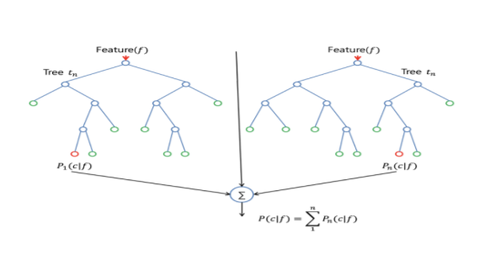
Random forest:
The random forest classifier was chosen due to its superior performance over a single decision tree with respect to accuracy. It is essentially an ensemble method based on bagging. The classifier works as follows: Given D, the classifier firstly creates k bootstrap samples of D, with each of the samples denoting as Di . A Di has the same number of tuples as D that are sampled with replacement from D. By sampling with replacement, it means that some of the original tuples of D may not be included in Di , whereas others may occur more than once. The classifier then constructs a decision tree based on each Di . As a result,

Slide 13

Where pi is the probability that a tuple in D belongs to class C i . The Gini index measures the impurity of D. The lower the index value is, the better D was partitioned.
a “forest" that consists of k decision trees is formed. To classify an unknown tuple, X, each tree returns its class prediction counting as one vote. The final decision of X’s class is assigned to the one that has the most votes. The decision tree algorithm implemented in scikit-learn is CART (Classification and Regression Trees). CART uses Gini index for its tree induction. For D, the Gini index is computed as:

Slide 14
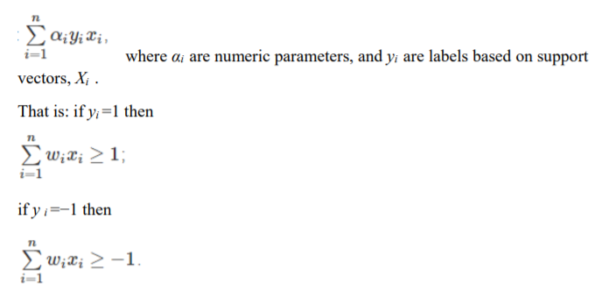
Support vector machine:
Support vector machine (SVM) is a method for the classification of both linear and nonlinear data. If the data is linearly separable, the SVM searches for the linear optimal separating hyperplane (the linear kernel), which is a decision boundary that separates data of one class from another. Mathematically, a separating hyper plane can be written as: W·X+b=0, where W is a weight vector and W=w1,w2,...,w n. X is a training tuple. b is a scalar. In order to optimize the hyperplane, the problem essentially transforms to the minimization of ∥W∥, which is eventually computed as:

Slide 15

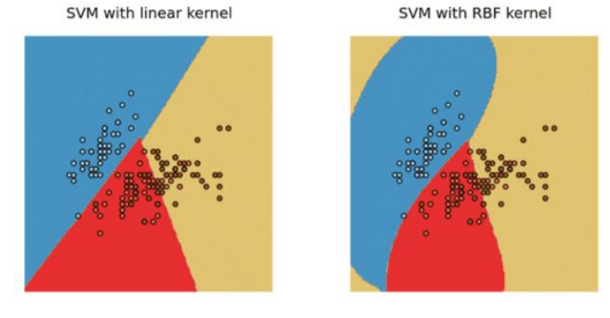
where Xi are support vectors, X j are testing tuples, and γ is a free parameter that uses the default value from scikit-learn in our experiment. Figure shows a classification example of SVM based on the linear kernel and the RBF kernel on the next page
If the data is linearly inseparable, the SVM uses nonlinear mapping to transform the data into a higher dimension. It then solve the problem by finding a linear hyperplane. Functions to perform such transformations are called kernel functions. The kernel function selected for our experiment is the Gaussian Radial Basis Function (RBF):

Slide 16
Logistic Regression:
Logistic regression predicts the probability of an outcome that can only have two values (i.e. a dichotomy). The prediction is based on the use of one or several predictors (numerical and categorical). A linear regression is not appropriate for predicting the value of a binary variable for two reasons: 16
• A linear regression will predict values outside the acceptable range (e.g. predicting probabilities outside the range 0 to 1)
• Since the dichotomous experiments can only have one of two possible values for each experiment, the residuals will not be normally distributed about the predicted line.
• On the other hand, a logistic regression produces a logistic curve, which is limited to values between 0 and 1. Logistic regression is similar to a linear regression, but the curve is constructed using the natural logarithm of the “odds” of the target variable, rather than the probability. Moreover, the predictors do not have to be normally distributed or have equal variance in each group. Logistic regression uses maximum likelihood estimation (MLE) to obtain the model coefficients that relate predictors to the target. After this initial function is estimated, the process is repeated until LL (Log Likelihood) does not change significantly.

Slide 17
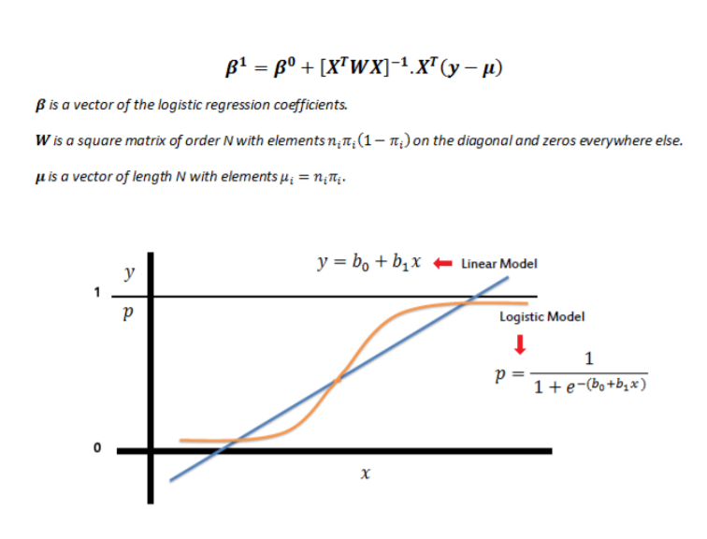

Slide 18
Convolutional Neural Network:
(CNN) CNN (Y. Le Cun et at al. 1990) are well-known for extracting features from a image by using convolutional kernels and pooling layers to emulates the response of an individual to visual stimuli. Moreover, CNN have been successfully used not only for computer vision, but also for speech (T. N. Sainath et at al. 2015). For speech recognition, CNN is proved to be robust against noise compared to other DL models (D.Palaz et at al. 2015)

Slide 19
Facilities required for proposed work:
Hardware Requirements:
• Core i5/i7 processor
• At least 8 GB RAM
• At least 60 GB of Usable Hard Disk Space
Software Requirements:
• Python 3.x
• Anaconda Distribution
• NLTK Toolkit

Slide 20
Project Progress
Step 1 : Python and deep knowledge of ml libraries
Step 2 : knowledge of sound features like frequency domain features,spectrum etc.
25% complete.
Step 3 : build a audio convertor and buuld a dataset using it.
Step 4 : Acquiring deep knowledge of NLP and applying it on ravdess dataset to test model.
50% complete .

Slide 21
Conclusion:
Through this project, we showed how we can leverage Machine learning to obtain the underlying emotion from speech audio data and some insights on the human expression of emotion through voice. This system can be employed in a variety of setups like Call Centre for complaints or marketing, in voice-based virtual assistants or chatbots, in linguistic research, etc

